Slide 1
HUMAN DETECTION AND COUNTING
YOKESH.R- 200701303
HARISH KUMAR.S- 200701515
VIGNESHWARAN.R- 200701513

Slide 2
ABSTRACT
Counting people in visual surveillance is hard and challenging problem. Automatic counting surveillance of individuals publicly areas is vital for safety control. Previously many techniques and methods are proposed. These methods/techniques aren't producing accurate and high performance for difficult situations.In our project we are going to detect humans by using videos by using some of the machine learning and open cv algorithms we will identify the human and assign a private id and therefore the count it accordingly. The research for biometric authentication of a person has reached far but the real-time tracking of human beings has not gained much importance .for better advancements we can implement this in future with advanced technologies.

Slide 3
INTRODUCTION :COMPUTER VISION
Computer vision is an interdisciplinary scientific field that deals with how computers can gain high-level understanding from digital images or videos. It is most widely used field of artificial intelligence (AI) that enables computers and systems to derive meaningful information from digital images, videos and other visual inputs. different types of computer vision include image segmentation, object detection, facial recognition, edge detection, pattern detection, image classification, and feature matching. Computer Vision itself is a big domain and is divided into various subdomains like scene reconstruction, object detection, event detection, video tracking, object recognition, 3D pose estimation, learning, indexing, motion estimation, visual serving, 3D scene modeling, and image restoration.

Slide 4
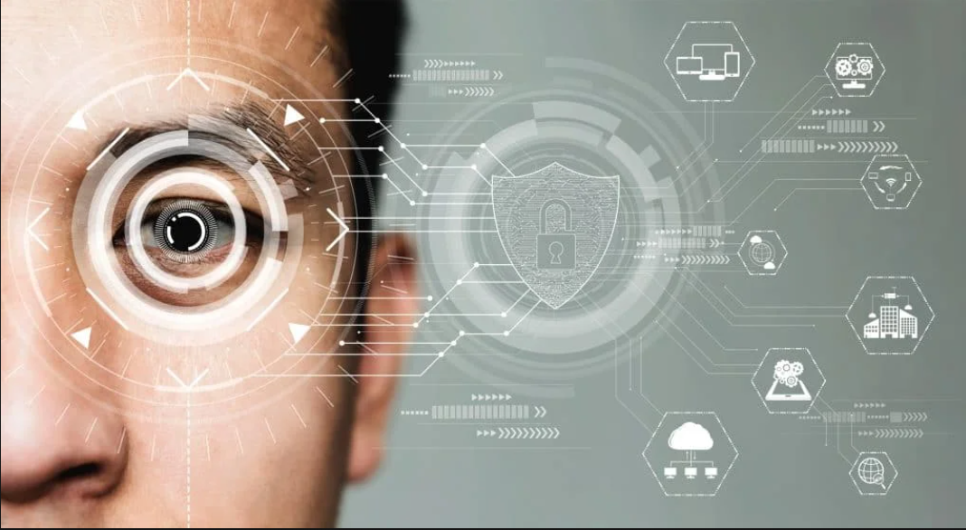
APPLICATION OF COMPUTER VISION
Object Detection
Screen Reader
Intruder Detection
Robotics
Image Restoration
Motion Analysis

Slide 5
DETECTION AND ENUMERATION IN CV
Detection is a computer technology related to computer vision and image processing that deals with detecting instances of semantic objects of a certain class (such as humans, buildings, or cars) in digital images and videos.
For Detection process in computer vision, there are various methods and each one have different level of accuracy according to their advancement level, like is some methods that is invented in very early stage, they give more cases of false detection as compared to the advanced methods that had been discovered after that and here we have used the human as an entity which we are detecting our project and along with that, we are also counting humans through image, video and camera.

Slide 6
HISTOGRAM OF ORIENTED GRADIENT
It is well known that Histogram of Oriented Gradient (HOG) is quite a popular method of detecting people in static image. HOG is developed from the SIFT feature and is used to describe the body’s shape information by gradient direction histogram of small pieces. The image is first divided into blocks while these blocks overlap with each other. Each block contains four cells.
A histogram is calculated for each cell, and the volume of each bin is the sum of magnitude of the pixels whose orientations are in the corresponding angle interval. In our implementation, each block contains 2×2 cells, so a block can be represented by a 36-dimensional vector and the resized window is 64×128.

Slide 7
SVM(SUPPORT VECTOR MACHINE)
SVM stands for Support Vector Machine. SVM is a supervised machine learning algorithm that is commonly used for classification and regression challenges. Common applications of the SVM algorithm are Intrusion Detection System, Handwriting Recognition, Protein Structure Prediction, Detecting Steganography in digital images, etc.
In the SVM algorithm, each point is represented as a data item within the n-dimensional space where the value of each feature is the value of a specific coordinate.

Slide 8
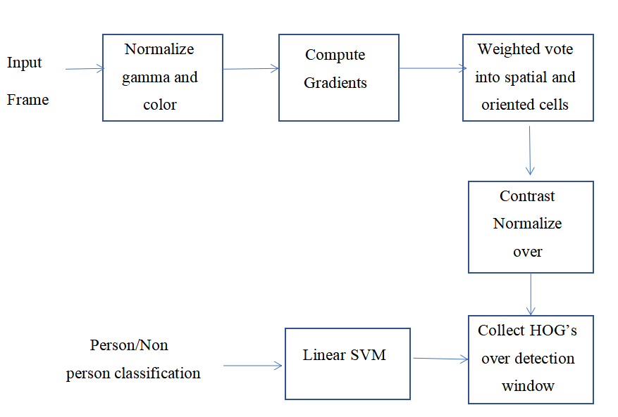
WORKING:

Slide 9
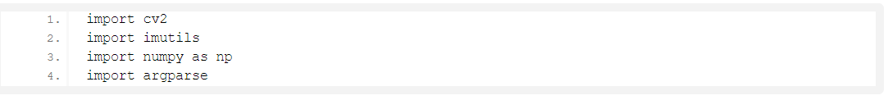
CODE:

Slide 10
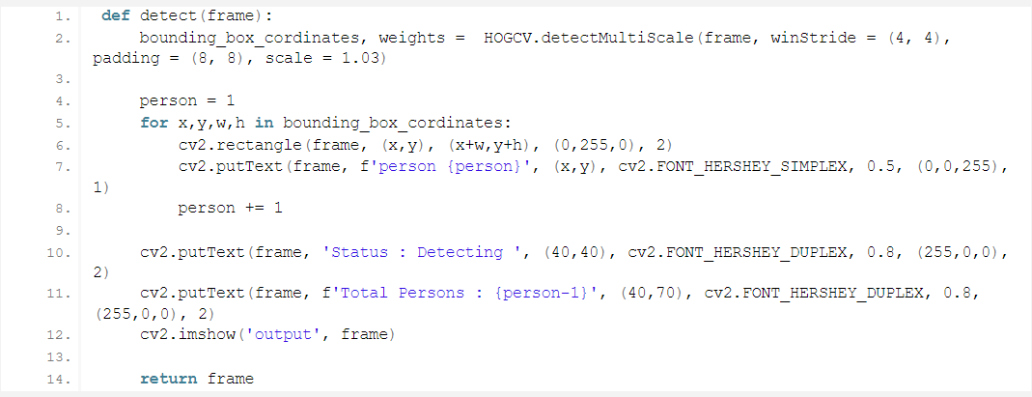
CODE

Slide 11
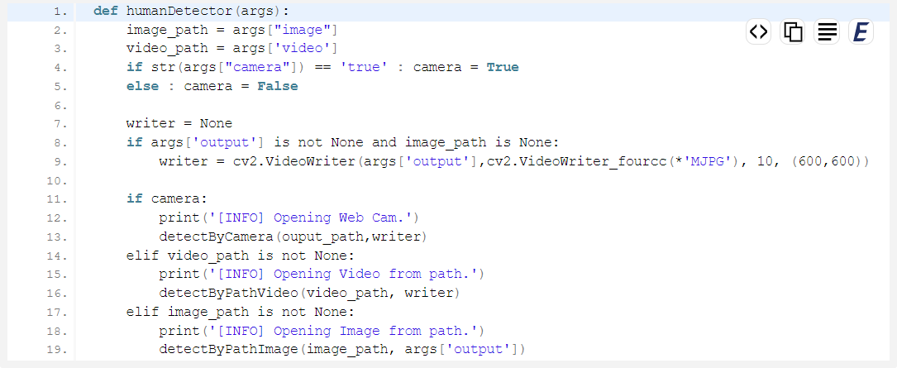
CODE

Slide 12
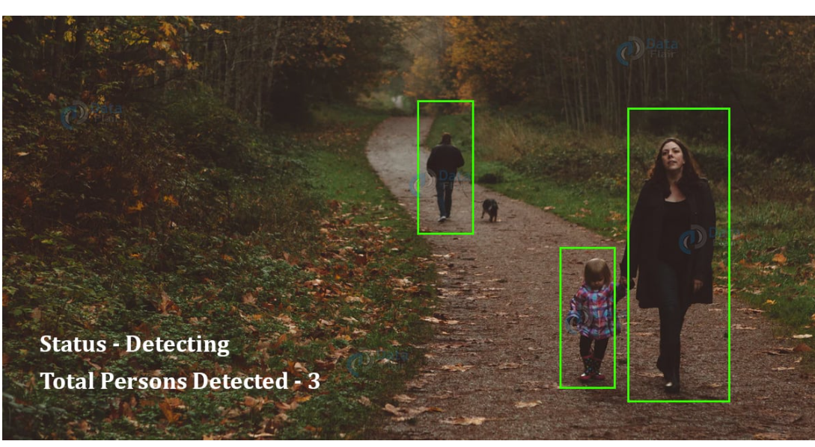
OUTPUT:

Slide 13
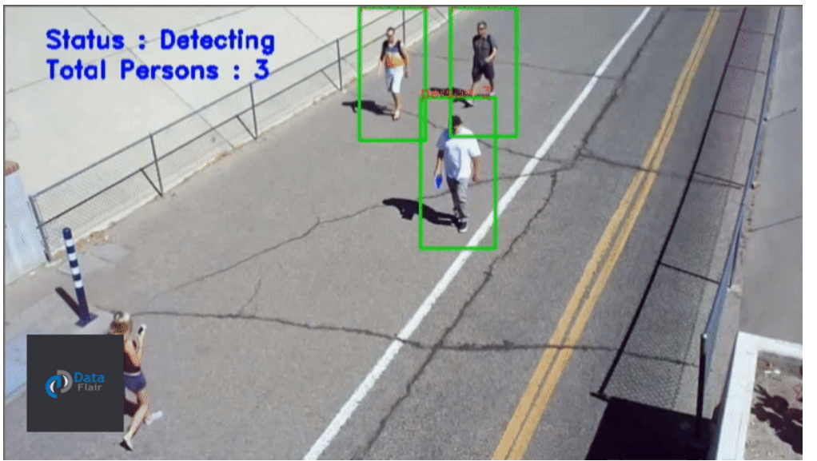
OUTPUT

Slide 14
FUTURE SCOPE:
It is particularly very important to collect and train as much real-world data as possible. Model can be optimized for faster inference. Thus, the model’s overall performance and accuracy measures can be further enhanced by increasing the dataset used for training with real-world data and we can also track human by using fuzzy logic.

Slide 15
THANK YOU !

